Slide 1



Texas Community Development Block Grant Program
CDBG Over Coffee
Today’s Topic:
Force Account
Notes:
Good afternoon
Welcome and thanks for joining us for another CDBG Over Coffee, today’s topic is Force Account.

Slide 2

Introduction
What is Force Account (FA):
    A public agency to utilize its own workforce
Why do Grant Recipients use it?
    Mainly used for construction work as a cost saving measure
Notes:
The term "force account, or F-A," originates from the idea that a public agency can utilize its own workforce to complete a project, essentially acting as its own contractor rather than hiring an outside company. Thus, the “force” refers to the public agency’s own internal workforce and "account" meaning keeping track of the labor, materials, and equipment used. In this presentation we will refer to Force Account performed by the Grant Recipient’s staff, but keep in mind that FA can also be performed by employees of the benefiting utility, such as a Water Supply Corporation’s laborers.
Why do Grant Recipients use Force Account? Basically, as a cost saving measure. When using local staff instead of contracted labor, the laborers are not governed by Davis-Bacon and Related Acts and not required to pay the local prevailing wage. This frees up funds for materials to increase the scope of work to the maximum extent possible.

Slide 3
Disadvantages
The Grant Recipient is solely responsible for the project’s success
  Risks of slower construction and lack of warranties
Complex record-keeping requirements
Notes:
A common disadvantage occurs when using FA construction, because the grant recipient is solely responsible for the project’s success, including timelines, equipment, and labor. So, if something adversely impacts the project it is up to the grant recipient to resolve. While an acceptable risk for well-equipped grant recipients, this can be disastrous and costly for ill-prepared ones.
Another disadvantage is that force account inherently involves a significant amount of paperwork to document the time and costs associated with laborers and equipment. This is significant for both the grant recipient and the grant administrator, as both need to make sure that the force account documentation is completed correctly.

Slide 4

Contractors vs. Employees
Importance of employee status
      W2 – Eligible for FA
      1099 – Not eligible for FA
Infrequent use of FA
    Temporary employees hired, not simply contracted
    Use of another public entity employees
Notes:
So, how is Force account classified? According to the IRS, force account is defined as labor classified as professional services, construction, rehabilitation, repair, or demolition performed by municipal, county or Council of Government employees. This distinction is often shorthanded by referring to the worker as either a “1099” or “W2”, the former being an independent contractor, ineligible for FA, and the latter being an FA eligible employee.
With that said, the Implementation Manual does allow for some infrequently used forms of Force Account.
First, the use of “temporary employees hired, not simply contracted is allowable. The grant recipient will need to document that such an arrangement is allowed by local hiring and employment policies. This is seldom (if ever) used for cost savings. Second, the use of employees from another public entity may be used for Force account via an intergovernmental agreement. We do see this arrangement occasionally.

Slide 5

Requesting approval
Two ways to request FA:
  At the time of the application
  During the life of the grant agreement
  Either stage requires the A808- Request to Use Force Account Labor
  If the Grant Recipient is using Force Account to self-administer the grant, the assigned administrator must be Certified.
Notes:
Requesting Force Account may be done in two ways.
First, by submitting the A808 Request to Use Force Account Labor form at the time of application, or second, at any time during the life of the Grant Agreement. If the Grant Recipient requests FA at the application stage, the form will be reviewed for completeness and appropriateness based on the activity being proposed. If the Grant Recipient did not anticipate needing force account, but does so now, a Materials and Service Record (MSR) will need to be initiated. Select “Force Account Labor” as the method of completing work and upload the completed and signed A808.
Please note that if a Grant Recipient is using FA to self-administer their grant agreement, the assigned administrator or administrators must be CDBG Certified. More information on Administrator Certfication is available at our CDBG website.

Slide 6
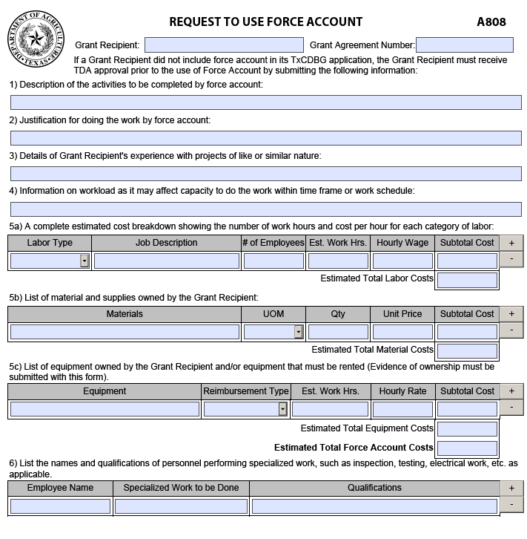
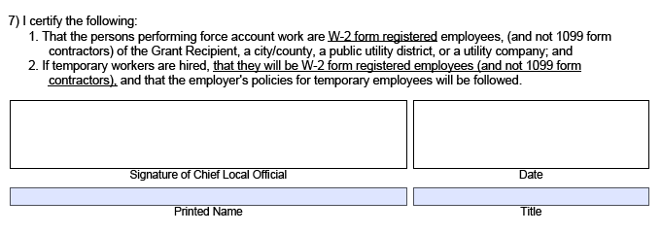
Form A808-Request to Use Force Account
When completing the form:
    Explain what the FA is for
    Justification for doing so
    Explanation of previous experience
    Provide type of labor, material and equipment
    List of persons needed to perform the work
Notes:
Form A808 is comprised of several sections requiring the Grant Recipient to first explain what they are going to do using FA, a justification for doing so, and explanation of previous experience doing this type of project, and any other factors that may be pertinent. Next, the form captures the type of labor, material, and equipment that will be used as force account on the project. Lastly, a list of persons that may be needed to perform specialized work on the project and their qualifications to do so.

Slide 7
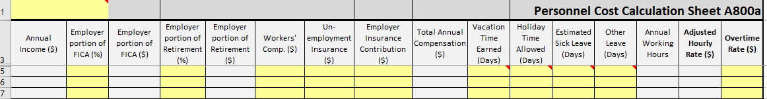
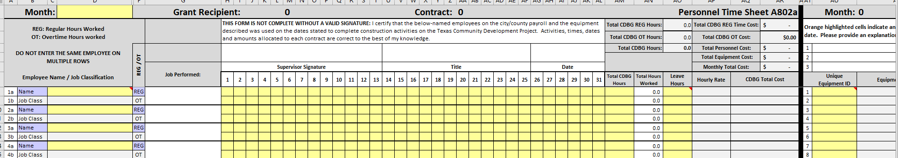
Form A800-Force Account Timesheet
Use Force Account Time Sheet (A800) form for grant or match funds
  Document eligible hourly cost for employees and equipment
  Form may be updated if additional personnel or equipment is added
  Cost not listed will not be reimbursed
Personnel
Time Sheet
Notes:
If the Grant Recipient is going to use force account with grant or match funds, the Force Account Time Sheet (A800) must be uploaded to the MSR in TDA-GO, to document the eligible hourly costs for employees and equipment that are assigned to the project. This form may be updated if additional personnel or equipment is added to the project. Costs for employees and equipment not listed on this document will not be reimbursed. TDA recommends using the Force Account Timesheet (Form A800) to document the monthly time sheets for all personnel and equipment labor hours claimed when submitting a Payment Request for reimbursement of grant or match funds.

Slide 8
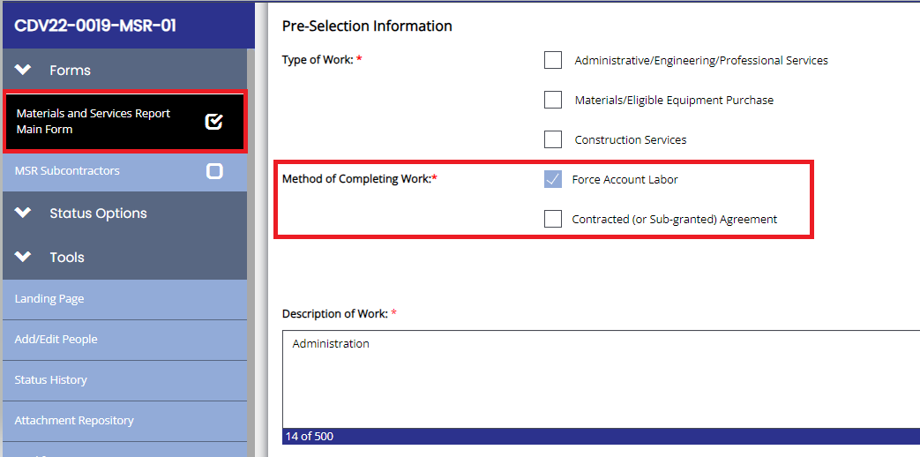
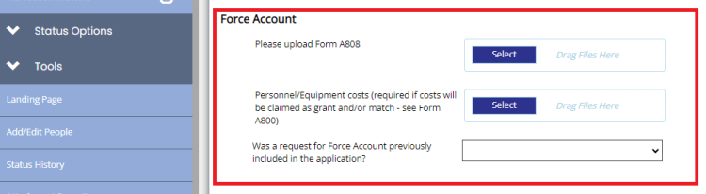
Material and Services Report
Notes:
Now that the forms have been completed a Force Account MSR must be created to record following information:
The type of work for force account
The description of the work
A financial disclosure that will be marked as 0.00 at the start since the actual amount will not be known until the end of the project, and
Documentation if Force Account was requested during the application phase.
As a best practice, before before submitting the MSR, please make that Form A808 and From A800 have been upload in the report.
Once the report is completed and the forms uploaded, select the Submit Vendor Selection button and submit the report.

Slide 9
Force Account and Materials
Materials used are eligible cost but must be procured accordingly.
When using materials on hand, must provide original procurement documents.
Must reimburse TDA for materials not installed.
Notes:
Materials used in the construction of the project are eligible costs, but they must be procured according to the requirements on Chapter 5 of the Implementation Manual. This also applies to materials on hand, so if a grant recipient intends to be reimbursed for items they already own, they will need to be able to document the original procurement, including costs for those materials.
For example, if a County has a stockpile of asphalt that they want to use on a street reconstruction project, they cannot just go out and get a current price for asphalt and use grant funds to replenish them at the current rate. The original procurement of the asphalt would need to be documented, and the County could only be reimbursed at the original purchase price.
If a grant recipient does procure materials according to the procedures in Chapter 5 and later determines that they did not need the quantities originally procured, the grant recipient will be required to reimburse TDA for materials not installed.

Slide 10
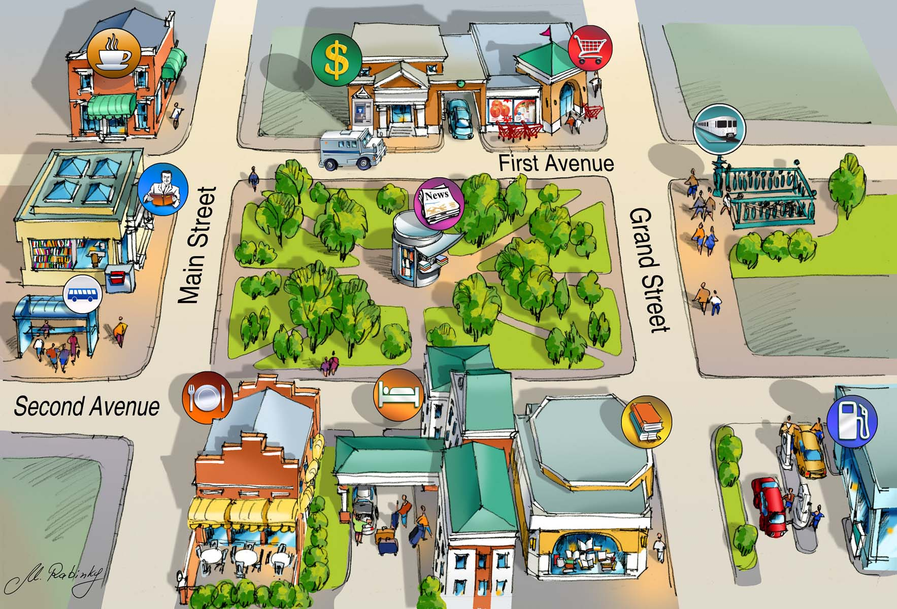
Payments request
Required documents:
    Map – for construction FA
        Identifies the worked area
    Back-up documentation
        Invoices, timesheets (form A800)
Notes:
Documentation is required for each Request for Payment when using for force account . These documents are:
• A map of the project area that clearly identifies the areas where work has been completed, the areas where work is included in the current request for payment, and the areas where work will be performed in the future; and
• Adequate back-up documentation (E.g., invoices, time sheets, etc.) to support the requested amount.

Slide 11

Closing out the Force Account MSR
  For Construction:
    Complete Form A807-Certificate of Construction Completion
  For Construction and Administrative Services:
    Complete Form A1022-Employer Certification Form
Notes:
Once the FA work has been completed and all the information has been entered into the forms, click on Begin MSR Completion Report and select the Work Completed tab and complete the form.
Also, in the MSR, click the word Here to generate Form A807 the Certificate of Construction Completion. The certificate must provide a detailed description of the quantities installed and the scope of the work performed.
Form A1022 the Employee Certification Form is required for administration and/or construction to capture the necessary Section 3 data.

Slide 12

Resources
Information on How to in TDAGO
Information on How to become a Certified Administrator
https://texasagriculture.gov/Grants-Services/Rural-Economic-Development/-TxCDBG-Rural-Community-Development-Block-Grant
Notes:
For more information on MSRs and how to become a certified administrator, please visit our Texas CDBG website and click on topics you are interest in.

Slide 13
Thank You For Your Attention
Time for Questions
Notes:
And this concludes our presentation, thank you for attending and now the microphones will open for questions.

